Slide 1
Forfending Against Phishing Attacks: A Cybersecurity Perspective

Slide 2
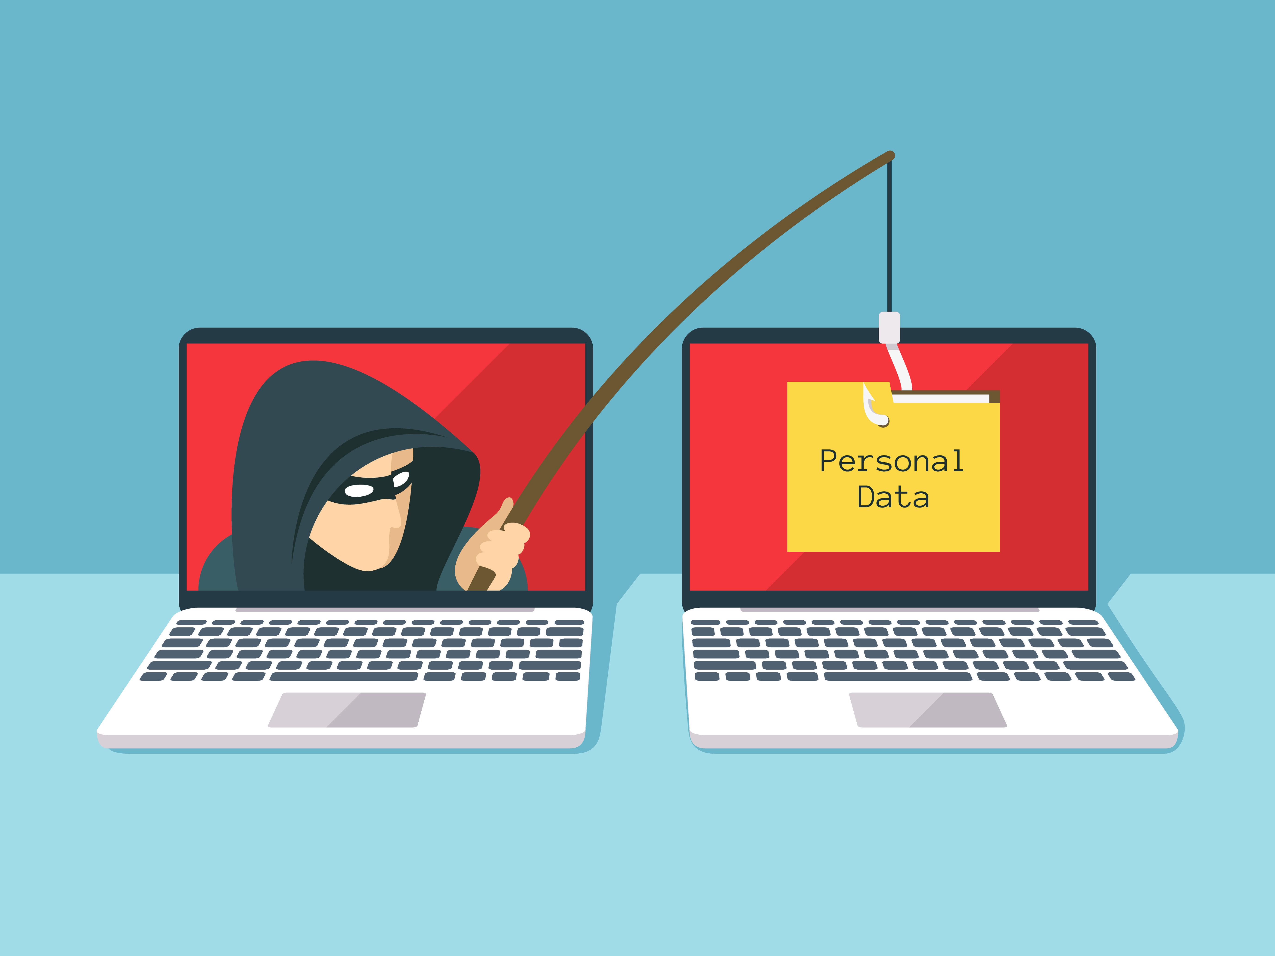
INTRODUCTION
Phishing attacks are in cybersecurity. They involve
endeavors to obtain sensitive information. This presentation will explore defensive stratergies against pishing attacks.

Slide 3
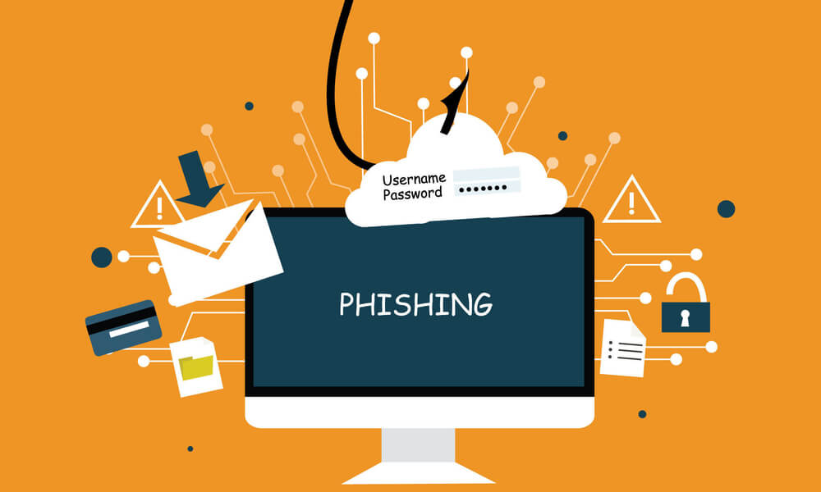
What is phishing?
Phishing is a convivial engineering attack that relies on
Assailers frequently impersonate legitimate entities to chicane victims into revealing confedential information.

Slide 4
types
Phishing attacks come in sundry forms, each aiming to apostatize individuals into revealing sensitive information or performing actions that compromise security. Here are some mundane types:
Email Phishing: Assailers send illusory emails pretending to be from legitimate sources, such as banks or companies, requesting personal information or clicking on maleficent links.
Spear Phishing: Homogeneous to electronically mail phishing but more targeted, spear phishing involves personalized emails aimed at categorical individuals or organizations, frequently utilizing information accumulated from gregarious media or other sources to appear legitimate.
Vishing (Voice Phishing): Assailants use phone calls to chicane victims into providing personal information or performing actions, frequently by impersonating trusted entities like banks or regime agencies.
Smishing (SMS Phishing): Phishing attacks conducted via SMS (text messages), where victims are lured into providing sensitive information or clicking on maleficent links sent through text messages.

Slide 5
Pharming: Assailers redirect victims to feign websites by tampering with DNS settings or utilizing malware. Victims unknowingly visit these sites and may enter sensitive information, cerebrating they're on legitimate sites.
Clone Phishing: Assailants engender fake duplicates of legitimate emails containing legitimate-looking but malignant links or affixments, aiming to illude recipients into revealing sensitive information or installing malware.
Whaling: Targeting high-profile individuals such as CEOs or high-ranking officials within organizations, whaling attacks involve personalized and sophisticated phishing endeavors aimed at glomming sensitive company data or financial information.
Angler Phishing: Exploiting convivial media platforms, assailants engender fake customer accommodation accounts or use subsisting compromised accounts to chicane users into revealing personal information or clicking on malevolent links.

Slide 6
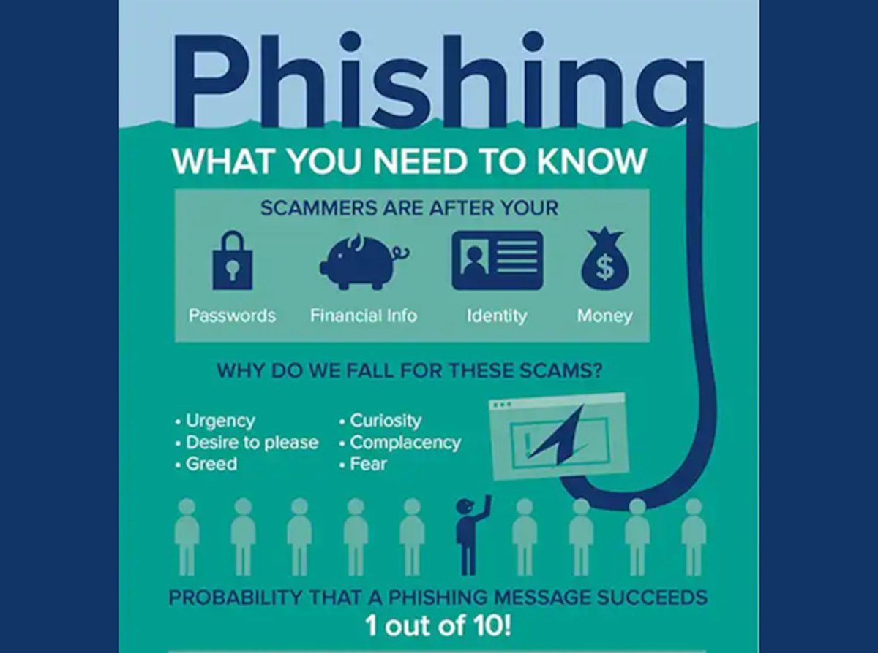
Common tactics
Phishers often use emails, mailicious attachments, and fake websites to deceive victims. Understanding these tactics is crucial for and prevention.

Slide 7
Impact
Financial Loss: Phishing attacks can result in financial losses for individuals or organizations due to glommed mazuma, fraudulent transactions, or identity larceny.
Data Breaches: Phishing attacks frequently lead to data breaches, compromising sensitive information such as personal details, authenticate credentials, financial records, or perspicacious property.
Reputation Damage: Organizations may suffer reputational damage due to phishing attacks, leading to loss of trust from customers, partners, or stakeholders.
Disruption of Operations: Prosperous phishing attacks can disrupt mundane business operations, leading to downtime, loss of productivity, and supplemental costs for instauration and remediation.
Identity Larceny: Phishing attacks can result in identity larceny, where assailers use purloined personal information to impersonate individuals for fraudulent purposes, such as opening accounts or applying for loans.
Licit and Regulatory Consequences: Organizations may face licit and regulatory consequences for failing to forfend sensitive information or breaching data auspice laws, resulting in fines, lawsuits, or other penalties.

Slide 8
Loss of Confidential Information: Phishing attacks can lead to the loss of confidential or proprietary information, compromising competitive advantage and perspicacious property.
Compromised Systems: Phishing attacks frequently involve the installation of malware or unauthorized access to systems, leading to further exploitation, data exfiltration, or compromise of network security.
Psychological Impact: Phishing attacks can have a psychological impact on victims, leading to feelings of susceptibility, distrust, or solicitousness about online interactions and security threats.
Cost of Remediation: Recuperating from phishing attacks can be costly, involving expenses for incident replication, forensic investigation, cybersecurity measures, employee training, and implementing enhanced security controls.

Slide 9
Defensive statergies
Employee Training: Edify employees about phishing threats, how to apperceive them, and what actions to take if they encounter suspicious emails, links, or affixments.
Email Filtering: Implement email filtering solutions to detect and block phishing emails afore they reach users' inboxes, minimizing the likelihood of prosperous phishing attacks.
Multi-Factor Authentication (MFA): Enable MFA to integrate an extra layer of security, requiring users to provide multiple forms of verification to access accounts or sensitive information.
Conventional Updates and Patch Management: Keep software, operating systems, and security solutions au courant with the latest patches and updates to address susceptibilities that could be exploited by phishing attacks.
Phishing Simulation Exercises: Conduct customary phishing simulation exercises to test employees' vigilance and replications to phishing threats, providing feedback and training predicated on the results.

Slide 10
Vigorous Password Policies: Enforce vigorous password policies, requiring employees to utilize intricate and unique passwords for their accounts and emboldening the utilization of password managers.
URL Inspection Implements: Use URL inspection implements or accommodations to verify the legitimacy of links in emails afore users click on them, availing to avert users from visiting malignant websites.
Security Vigilance Campaigns: Launch security vigilance campaigns to reinforce best practices for identifying and eschewing phishing attacks, keeping employees apprised about evolving threats and tactics.
Incident Replication Plan: Develop and customarily update an incident replication plan to outline steps for detecting, containing, and mitigating the impact of phishing attacks when they occur.

Slide 11
Thank you
Created by – mansha Bhardwaj

